Slide 1
Client Server Architecture
EN.600.444/644
Spring 2019
Dr. Seth James Nielson

Slide 2
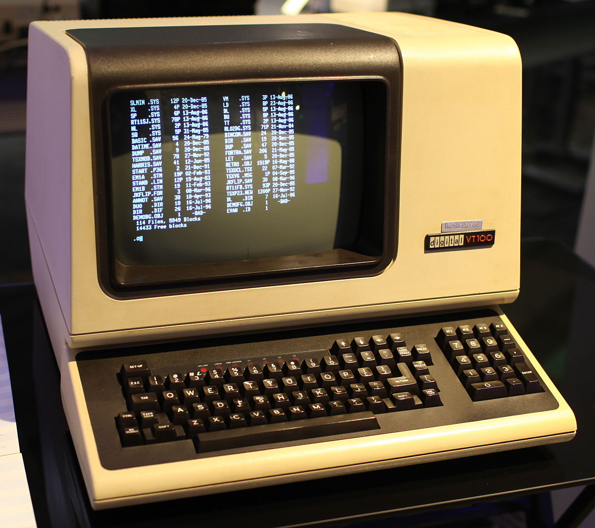

Computing 1960-1980 (ish)
NETWORK
This Photo by Unknown Author is licensed under CC BY-SA-NC
“DUMB” TERMINAL
MAINFRAME
This Photo by Unknown Author is licensed under CC BY-SA

Slide 3
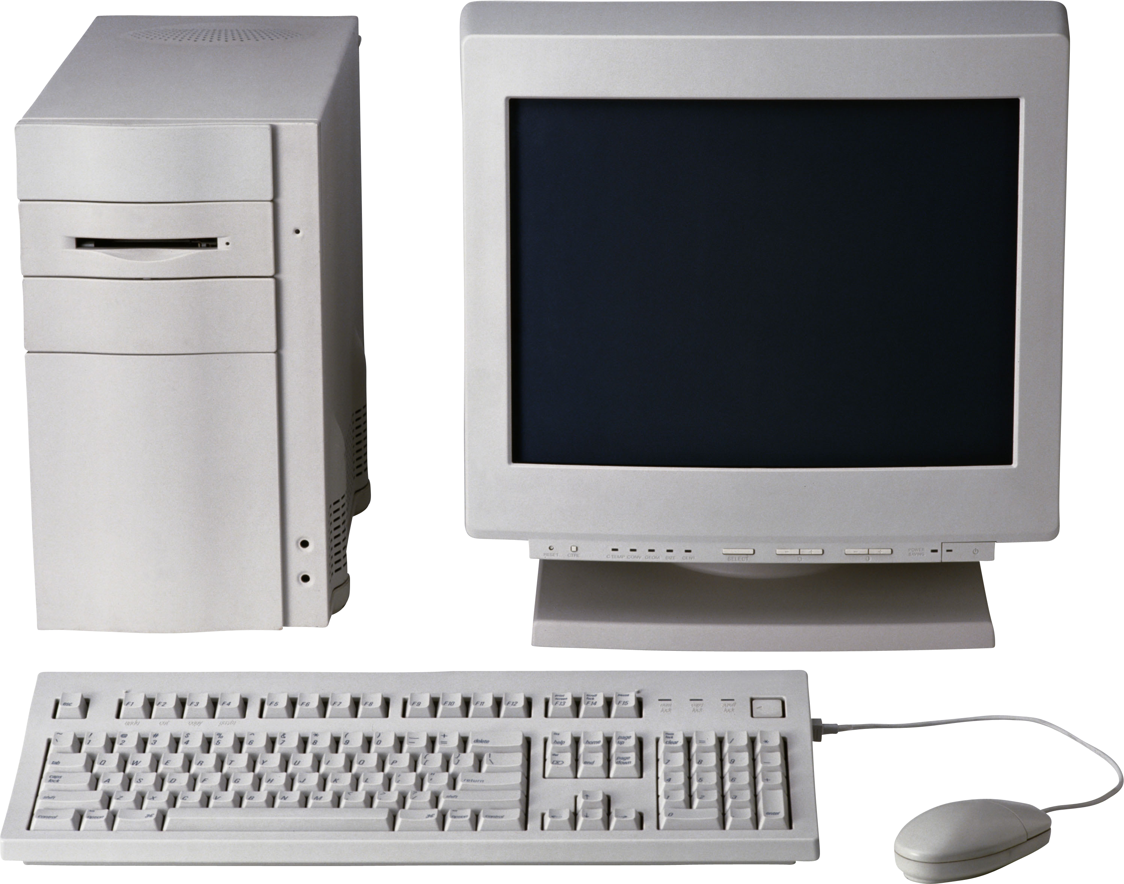
Computing 1980-2000 (ish)
This Photo by Unknown Author is licensed under CC BY-NC

Slide 4
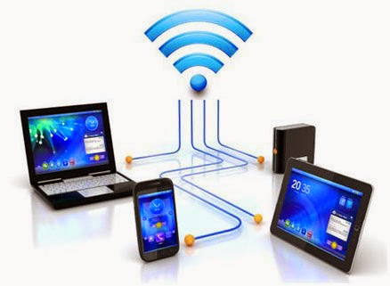

Computing 2000 – Present
NETWORK
This Photo by Unknown Author is licensed under CC BY
This Photo by Unknown Author is licensed under CC BY-NC-ND

Slide 5
General Ideas Behind Client-server
Put a bunch of resources in a high-performance, centralized machine
Clients can be much “dumber” by comparison
Much more efficient
Sharing data between devices, applications, and people (and marketing)
Access from multiple locations (including hackers!)
Time-sharing a central machine is more scalable and cost-effective

Slide 6
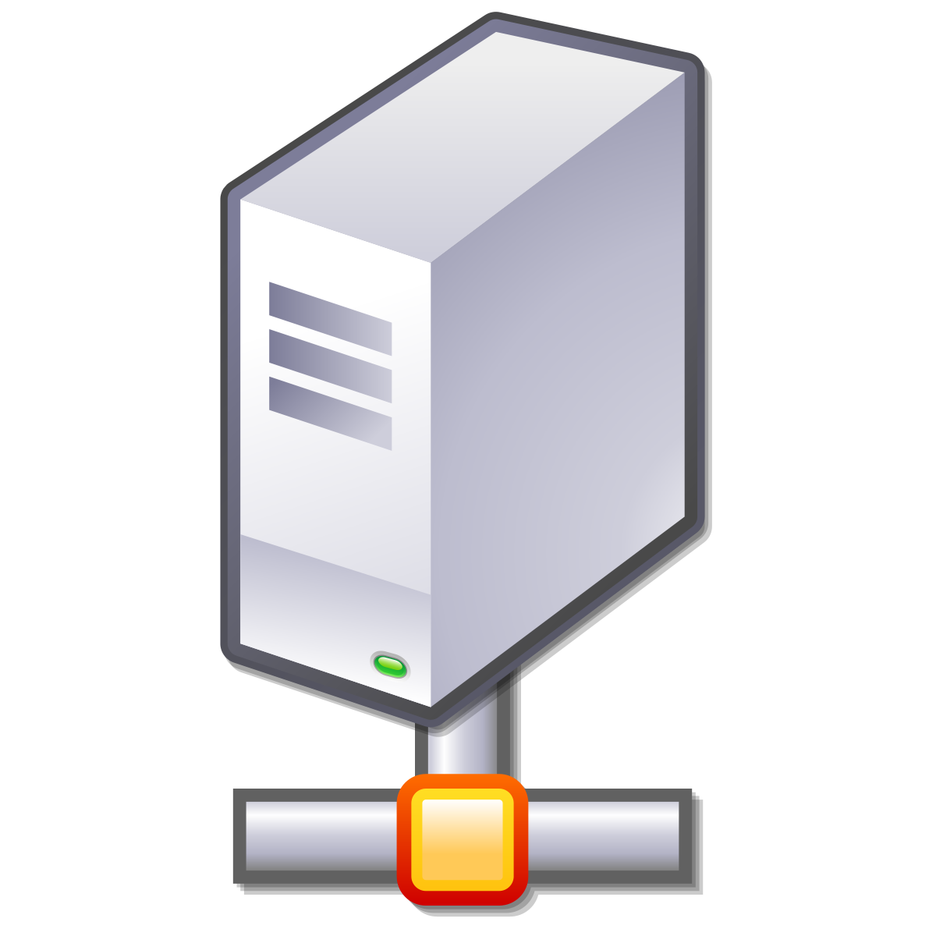
Server Abstraction
I’m Lonely. I wish someone would talk to me!
This Photo by Unknown Author is licensed under CC BY-SA
SERVER LISTENS FOR INCOMING REQUESTS

Slide 7

Preview of TCP/IP
Now I have an Address/Port! Maybe I’ll get Requests!
IP: 192.168.0.1
PORT: 80
This Photo by Unknown Author is licensed under CC BY-NC
This Photo by Unknown Author is licensed under CC BY-SA
SERVER HAS AN IP ADDRESS AND TCP PORT

Slide 8

Meanwhile, Client AbsTAction
HELLO?!
This Photo by Unknown Author is licensed under CC BY-NC
CLIENT CONNECTS TO MAKE OUTBOUND REQUESTS

Slide 9

TCP/IP Again
HELLO?!
TO: 192.168.0.1:80
FROM: 192.168.0.2:5280
Usually random
This Photo by Unknown Author is licensed under CC BY-NC
This Photo by Unknown Author is licensed under CC BY-NC
CLIENT CONNECTS TO MAKE OUTBOUND REQUESTS

Slide 10
Incoming Request
I GOT A REQUEST!!!
REQUEST
TO: 192.168.0.1:80
FROM: 192.168.0.2:5280
This Photo by Unknown Author is licensed under CC BY-SA
SERVER RECEIVES REQUEST

Slide 11
Request Response
MY NEW PENPAL!
RESPONSE
TO: 192.168.0.2:5280 FROM: 192.168.0.1:80
This Photo by Unknown Author is licensed under CC BY-SA
SERVER INVERTS TO/FROM FOR RESPONSE

Slide 12
Server Listens to Many Requests
SERVER USES (SRC IP, SRC PORT, DST IP, DST PORT)* TO MULTIPLEX
This is how one server on one port (e.g., webserver) handles many clients

Slide 13
Sockets
Sockets are a simple abstraction of client-server
Thus, there is a “client” socket and “server” socket
The server socket listens for incoming connections
The client socket makes an outbound connection to server
The server accepts the incoming connection and spawns a connected socket

Slide 14
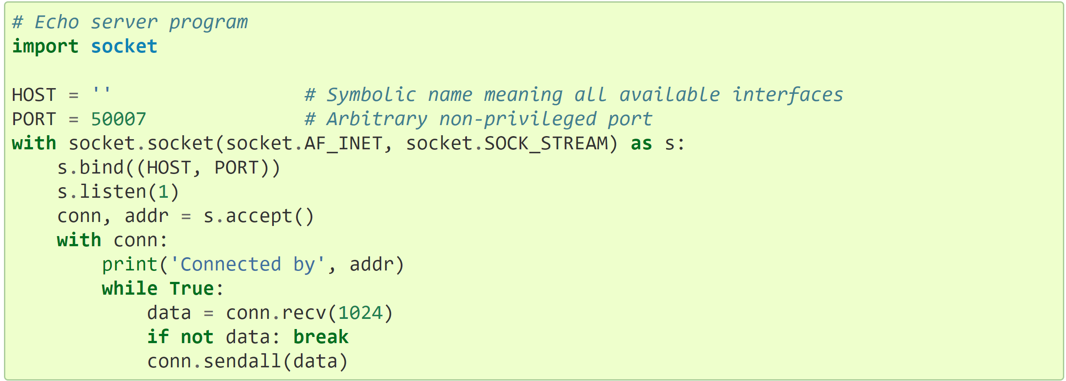
Python Server Socket
Basically, local IP address

Slide 15
Python Server Socket
IP network, Streaming is TCP

Slide 16
Python Server Socket
Listen with backlog of one

Slide 17
Python Server Socket
Accept the new incoming connection

Slide 18
Python Server Socket
This is the spawned socket for the specific
(SRC IP, SRC PORT, DST IP, DST PORT)
ALSO OF TYPE SOCKET!!!!!

Slide 19
Python Server Socket
With threads or non-blocking I/O, could
have two+ conn’s at the same time

Slide 20
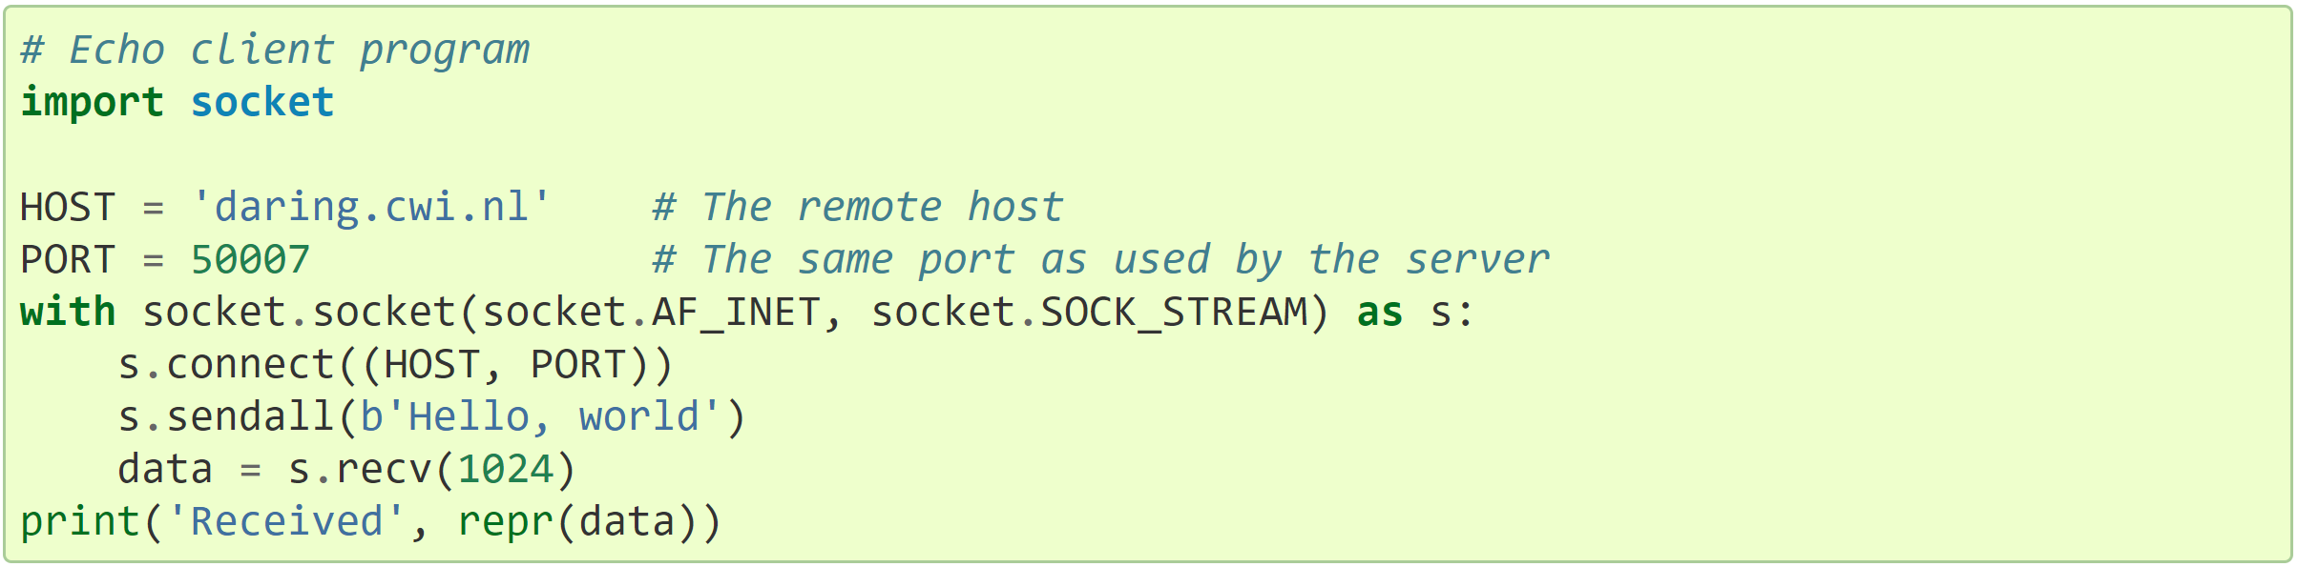
Python Client Socket
Server name (could also be IP addr)

Slide 21
Python Client Socket
Server port; client’s host/port determined
automatically

Slide 22
Python Client Socket
Blocking call; will raise exception on failure

Slide 23
Classic Sockets Design (Threads)
CLIENT 1
SERVER CONNECTIONS
(1 per thread)
CLIENT 2
CLIENT 3

Slide 24
Pseudo Code
server_socket.listen(backlog)
LOOP forever;
conn, addr = server_socket.accept()
run_thread(server_handling_function, conn, addr)

Slide 25
Classic Sockets Design (Events)
CONN 1
CLIENT 1
CLIENT 2
CONN 2
EVENT LOOP
CLIENT 3
CONN 3

Slide 26
PSEUDO CODE
server_socket.listen(backlog)
all_sockets = [server_socket]
LOOP forever
BLOCK until any socket in all_sockets is ready to read or write
ready_socket = socket in all_sockets ready to read or write
IF ready_socket == server_socket:
conn, addr = ready_socket.accept()
all_sockets.append(conn)
ELSE: handle client data

